Slide 1
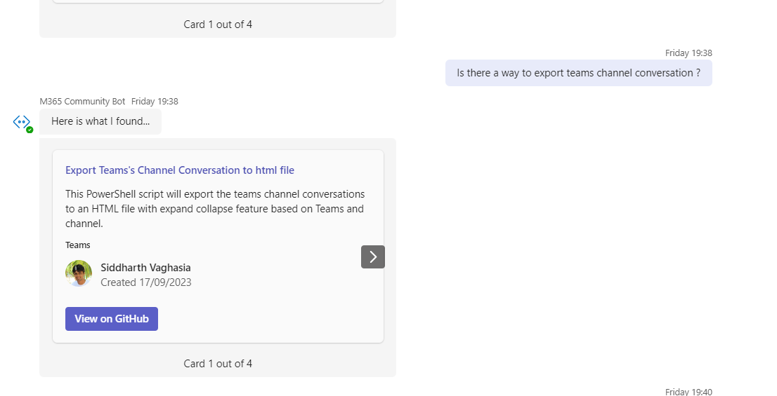
M365 Community Bot to find sample from the Sample solution gallery
Siddharth Vaghasia (@siddh_me)
Kunj Sangani (@kunj_sangani)

Slide 2












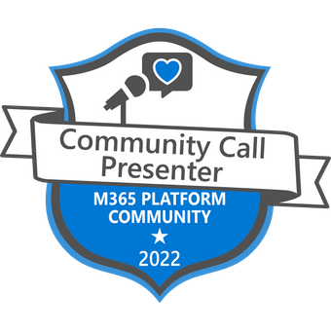

Siddharth Vaghasia
Microsoft 365 | Founder | BinaryRoots
SharePoint, Teams App, Power Platform, Azure, .NET
https://siddharthvaghasia.com
https://c-sharpcorner.com/members/siddharth-vaghasia
@siddh_me
siddharth-vaghasia
https://www.linkedin.com/in/siddharthvaghasia

Slide 3




Kunj Sangani
Technical Consultant - SharePoint, Office 365, Azure, .NET, NODE JS
Speaker | Blogger | PnP contributor | C# Corner MVP
https://www.c-sharpcorner.com/members/kunj-sangani
@sanganikunj
https://www.linkedin.com/in/kunjsangani
kunj-sangani
sangani.kunj@gmail.com
kunj.sangani

Slide 4

Idea & Driving factors
Explore and learn New Tech Stack
Checking the possibilities
Finding the data to be used
Just for fun

Slide 5
Summary
A Teams Bot which allows to find Community samples from Solution gallery
Natural language conversational bot
Usage of Open AI, Lang chain, Embeddings
Pinecone as Vector Storage
Sample gallery - https://adoption.microsoft.com/en-us/sample-solution-gallery/

Slide 6
Solution

Slide 7
Demo/ Code Walkthrough

Slide 8
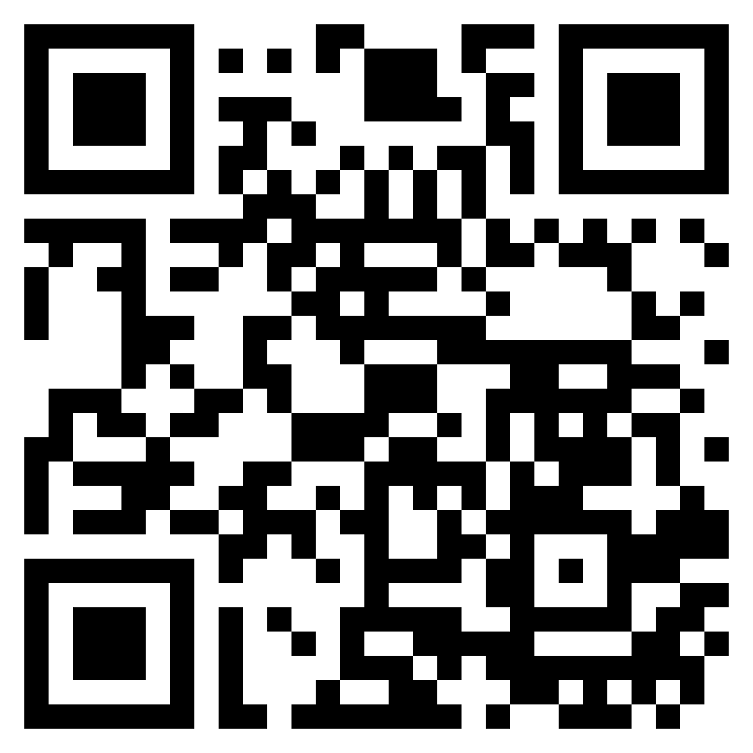
Link to Download the Package
https://github.com/binary-roots/M365-Community-Bot

Slide 9
What’s Next
Adding YouTube community videos
Publish to Microsoft App Source
Add few functionalities

Slide 10
THANK YOU

